Slide 1
PX4 System Overview
Sensors
GCS commands
Estimators
Pilot-in-command
Mode logic
Waypoint controller
Velocity controller
Attitude controller
Motors

Slide 2
PX4 System Overview
Motion capture
Sensors
Parameter identification
GCS commands
Estimators
Onboard SBC
New estimator
Pilot-in-command
Mode logic
Waypoint controller
Velocity controller
Attitude controller
New velocity controller
Motors

Slide 3
PX4 System Overview (baseline)
placeholder
Motion capture
Sensors
Parameter identification
GCS commands
Estimators
Onboard SBC
New estimator
Pilot-in-command
Mode logic
Waypoint controller
Velocity controller
Attitude controller
New velocity controller
Motors

Slide 4
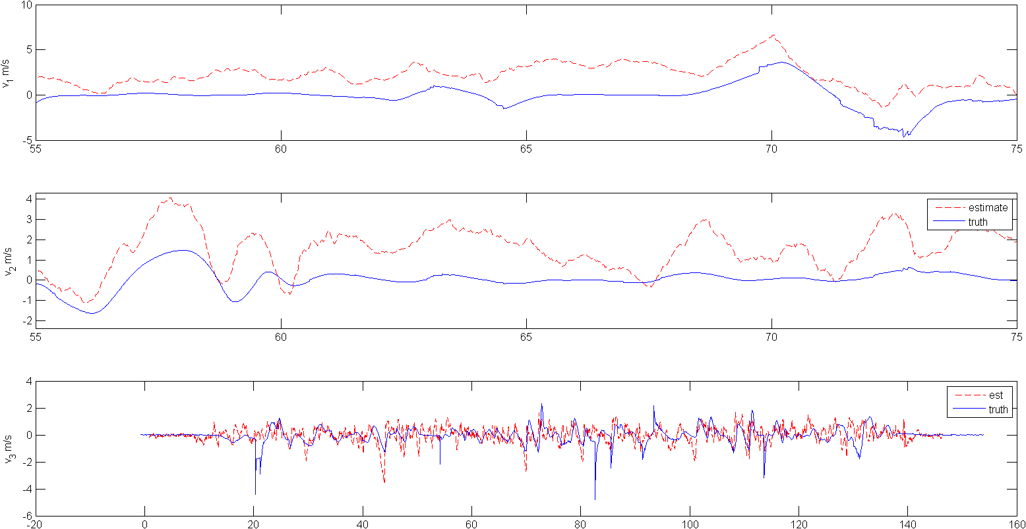
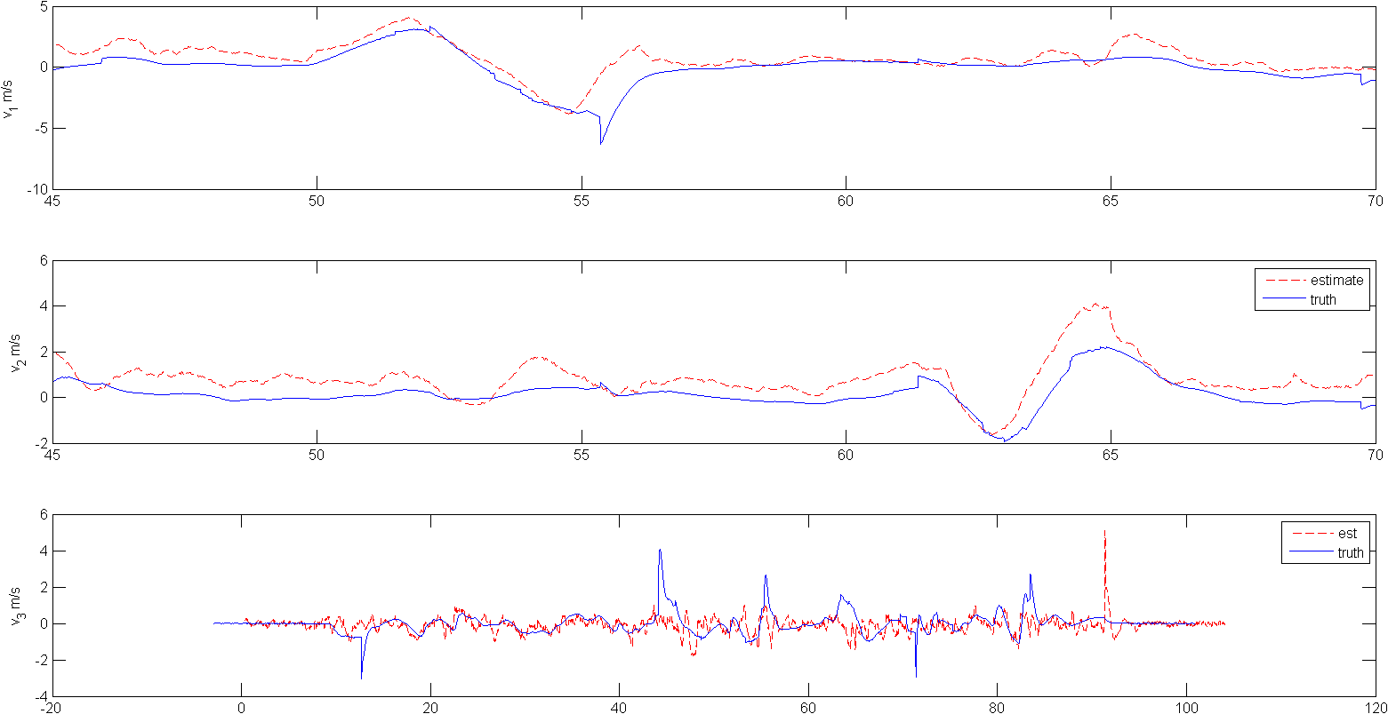
Motion capture
Analysis tools
Sensor characterization
Optic flow
Sonar
IMU
Drag coefficient
Above: early drag coefficient. Below: current
μ | S(v_{x}) (m/s) | S(v_{y}) (m/s)
Initial | 1.47 | 1.11
Current | 0.593 | 0.641

